Slide 1

Welcome to:
Maker Training Session
5:30 PM Tuesday, January 23, 2017
Broun Hall, Room 235

Slide 2


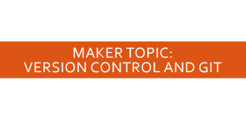

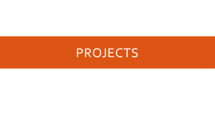
Agenda

Slide 3
About SPARC

Slide 4
Introduction
Student lead organization at Auburn University.
Creates and fosters an environment of creativity and innovation through collaborative projects.
A place to test out ideas, integrate concepts learned in class, and learn skills that will be instrumental when working in the workforce.
No prior experience is required, only a willingness to learn.
Great for students of all ages and majors.

Slide 5


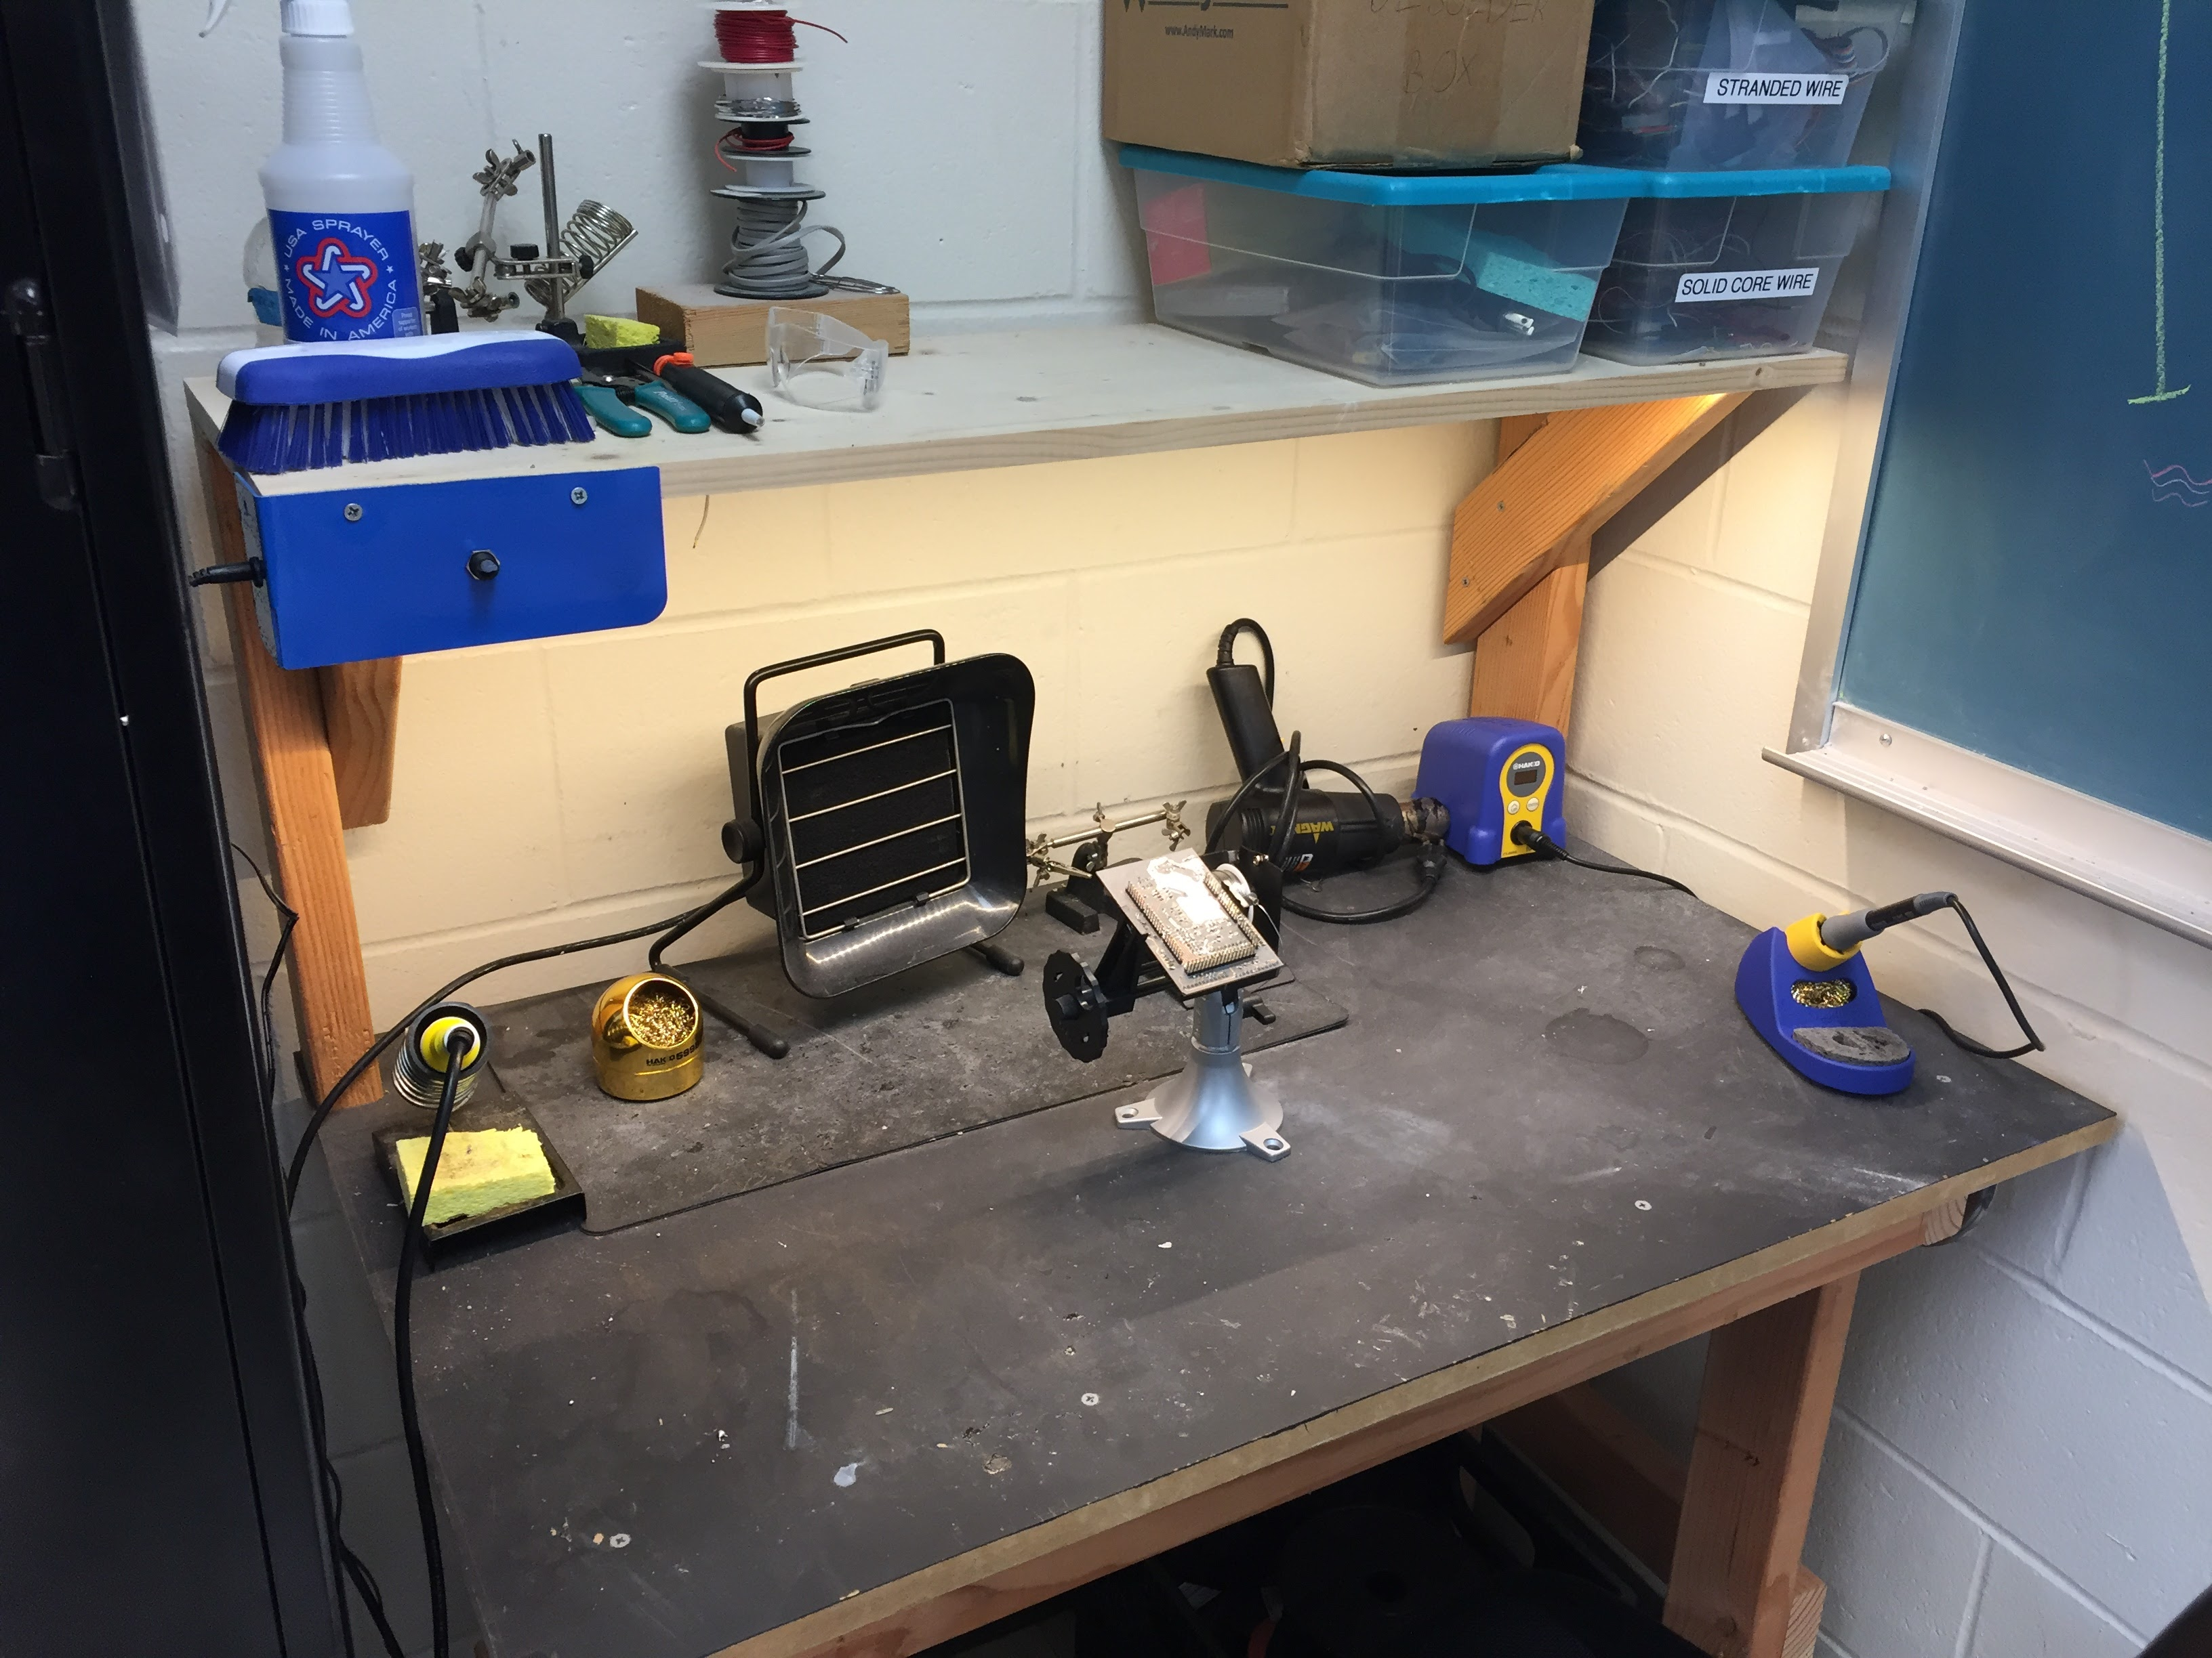
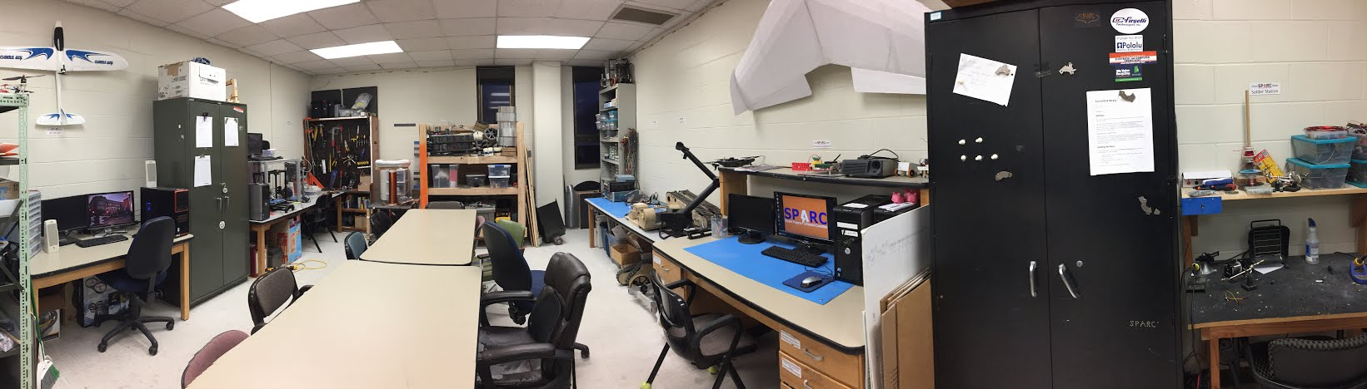
Our Lab
Broun Hall
Room 367

Slide 6
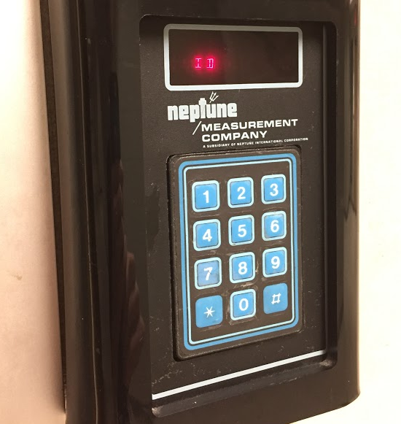
How to become a Member
Log 5 constructive hours in the lab
Write the times on the sheet on the clipboard next to the door.
Contact us at sparc.auburn@gmail.com
We will respond with the instructions to get an access code.

Slide 7
SPARC Meetings
Open Forum
Discuss status of active projects
Learn about and discuss specific topic in the realms of technology, engineering or making.
Wednesdays at 6:00 PM
Maker Training Session
Learn about a specific skills like 3D printing, CAD, electrical prototyping, and robotics.
Centered around SPARC Sumo Bot Competition
Tuesdays at 5:30 PM
Project Meetings
Project members come together to talk about detailed progress.
Meeting times and locations vary from project to project.

Slide 8



Partner Organizations
NASA Robotics Mining Competition Team
President: Jeremy Frasher <jjf0010@auburn.edu>
Meets on Mondays 6-7, SPARC Lab, Broun 367
RC Hobbyist Club
President: Craig Legrand <cbl0019@auburn.edu>
Meets on Mondays 3:30-4:30, SPARC Lab
Fridays 3:30-5:00, Broun 235
IEEE Auburn University Student Branch
President: Michelle Kniffen <mek0027@auburn.edu>
Meets on announced Mondays, Broun 238

Slide 9




More Information about SPARC
Website
http://sparc-auburn.github.io/
Github
https://github.com/SPARC-Auburn
Slack
https://sparc-auburn.slack.com/
Email
sparc.auburn@gmail.com

Slide 10
Outreach

Slide 11
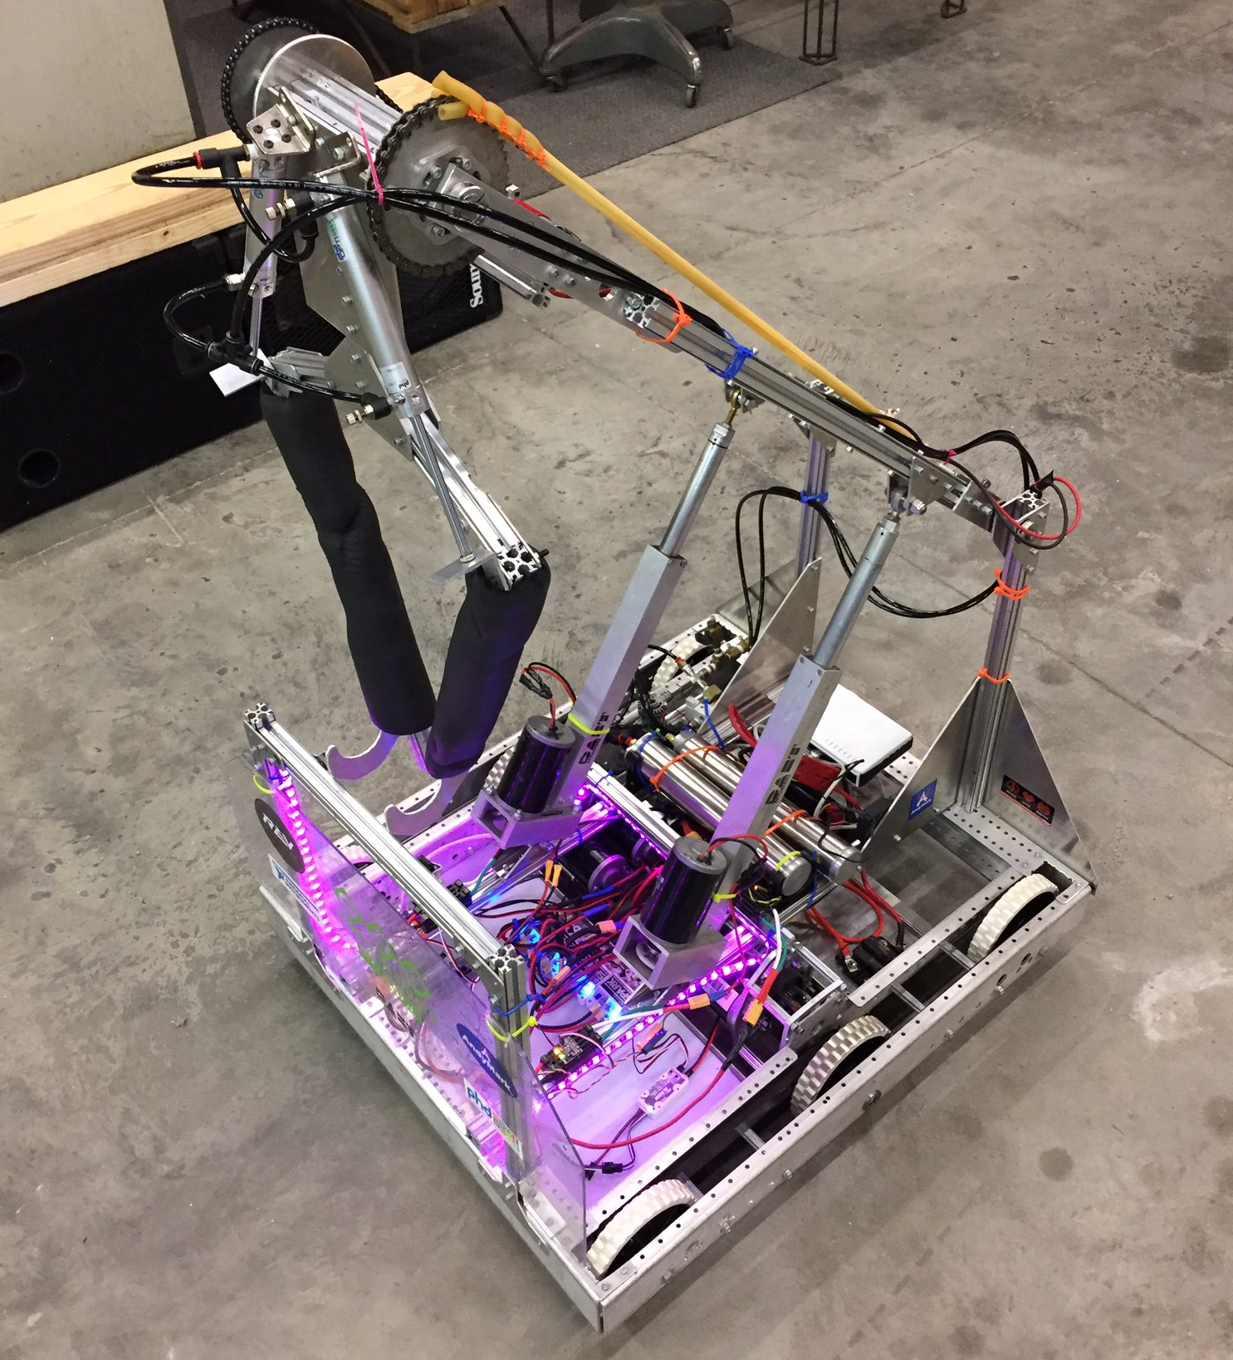
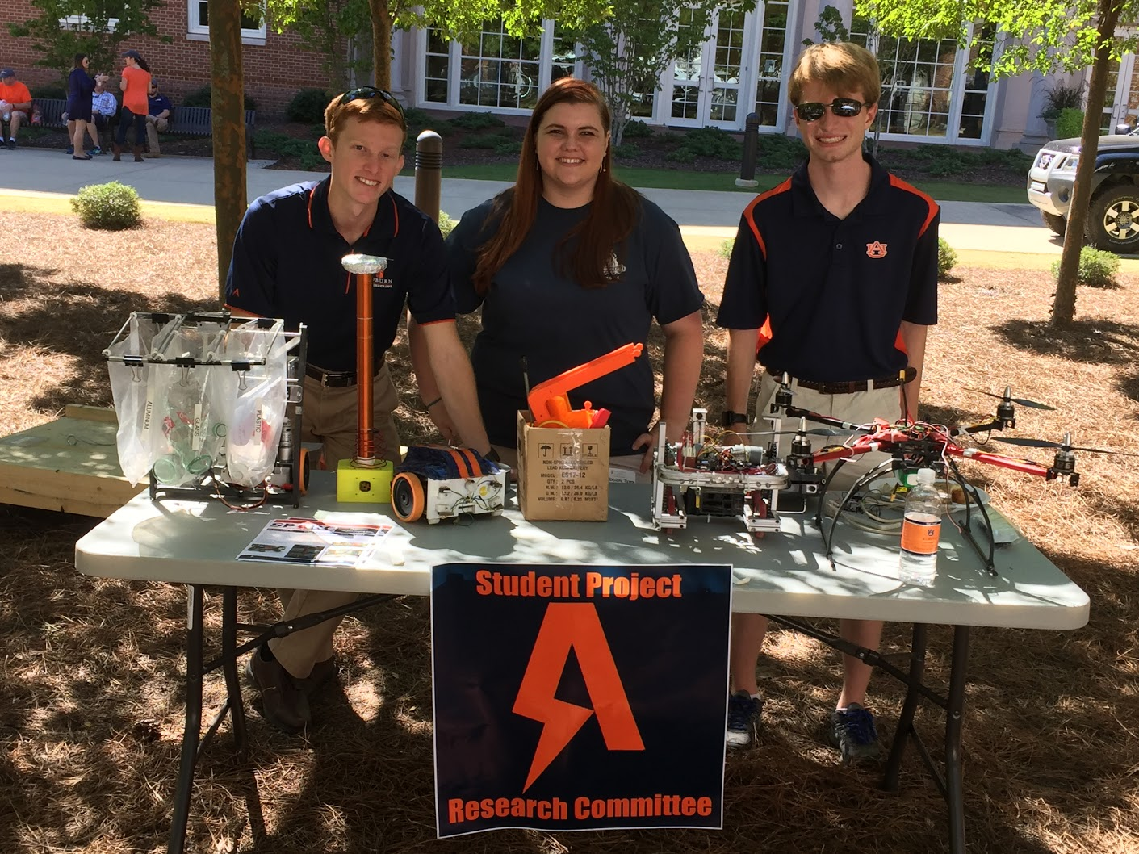
Outreach Events
Opelika HS FRC Team
Help mentor a FIRST Robotics Competition (FRC) Team
Mon Tue Thu: 3:30-6:30, Fri: 3:30-9:30, Sat:10-6
E-Day
Help display projects in Broun, Student Center, and Concourse to high school students.
Friday, February 23rd
Robot in 3 Days 2018 Bot
Engineering Tailgate 2016 SPARC Table
Notes:
Fall 2016
Loachapoka Robotics Mentoring- Mondays, Tuesdays, and Thursdays 3:00PM to 4:30PM
ECE Minority Presentation- November 14th
AJHS E-Day- November 17th
South’s Best- December 3-4th
SCORE Claw Machine- December 3-4th
Spring 2016
E-Day- Late February or early March
SPACE Day- Possible Event Next Semester
IEEE Sumo Robotics Competition (with local middle and high schools)- Spring 2017

Slide 12
Projects

Slide 13
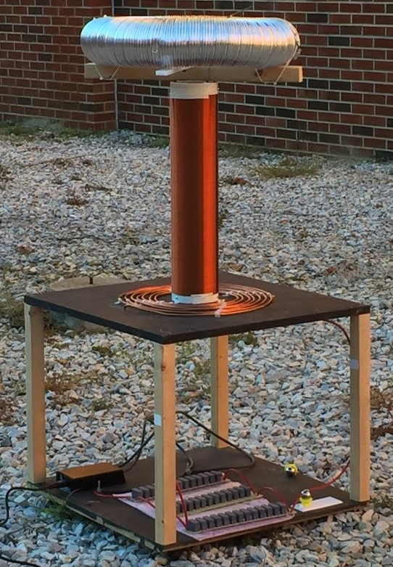
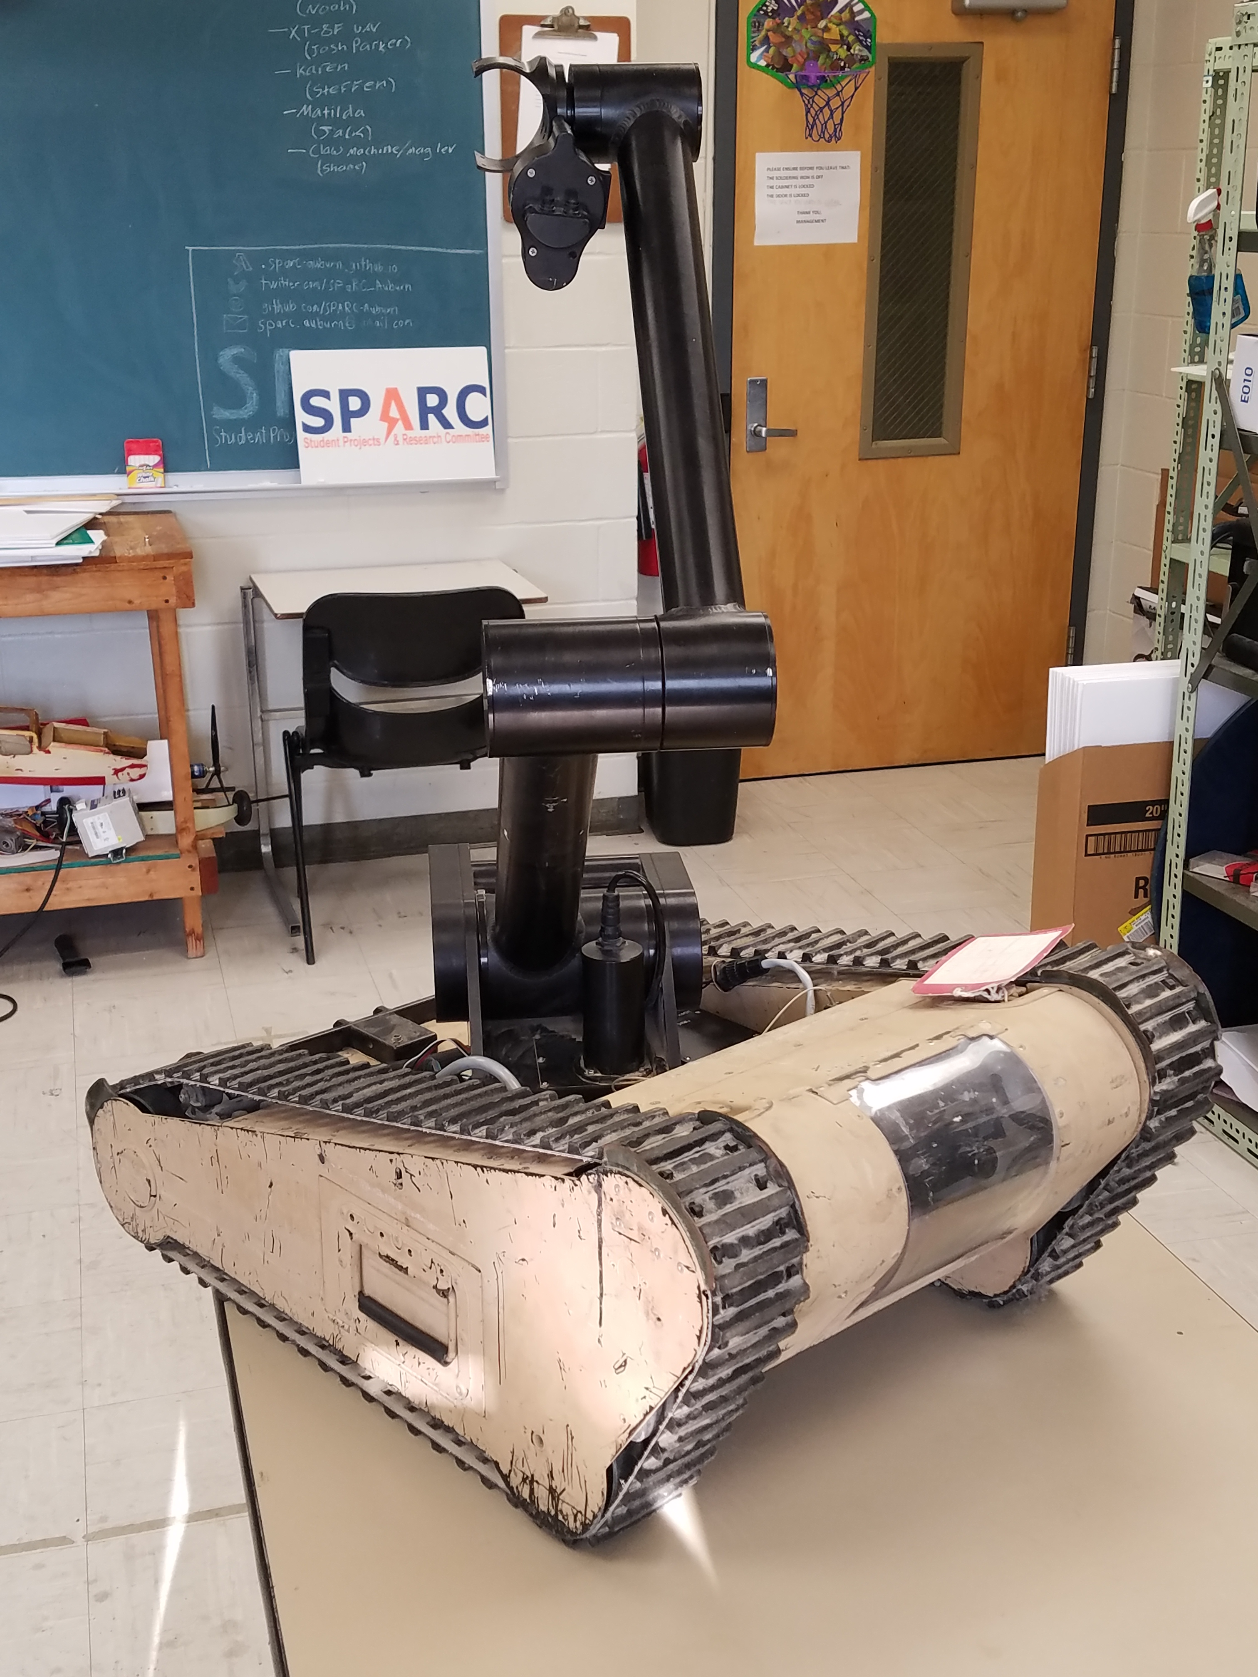
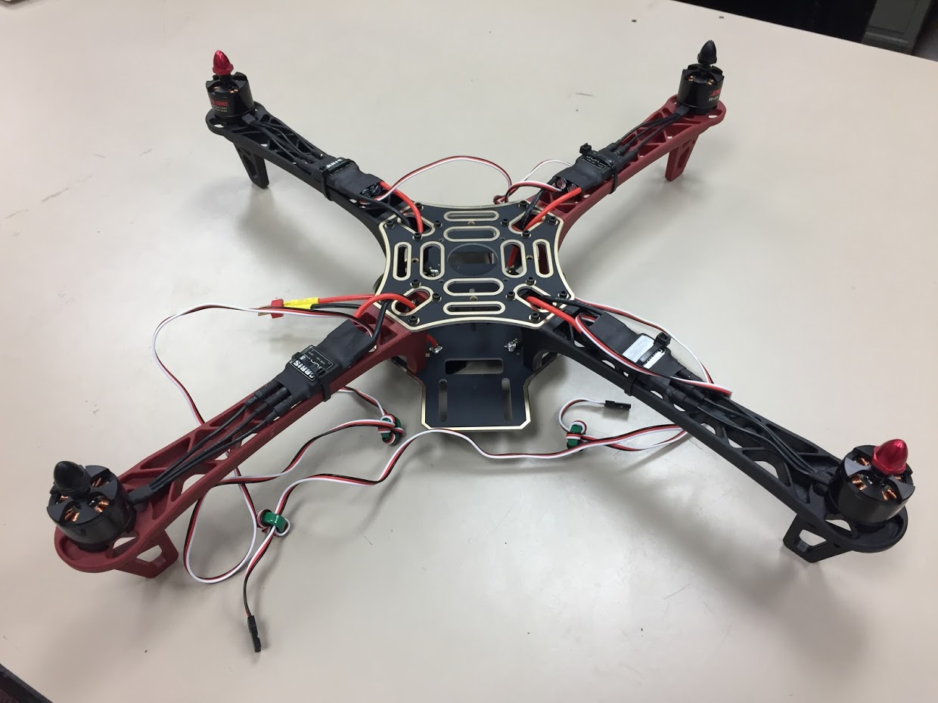
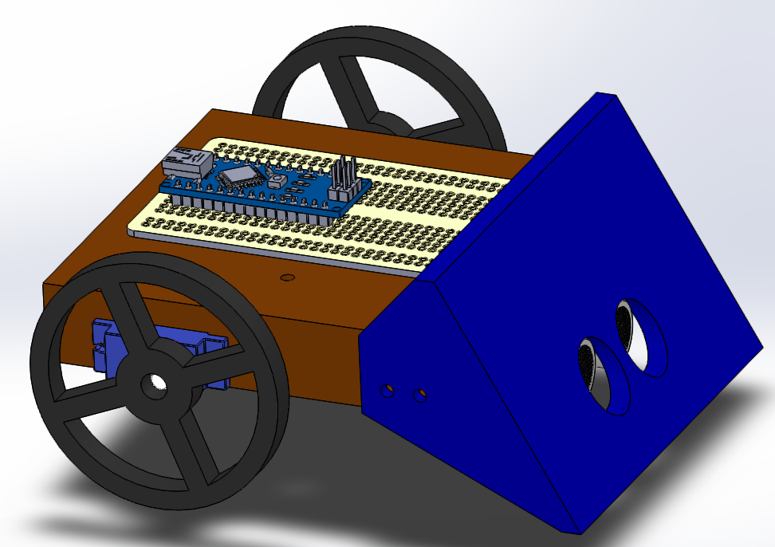
Spring 2018 Main Projects
MATILDA Robotics Platform
Tesla Coil
Unmanned Aerial Systems
Sumo Bot Competition

Slide 14
Sumo Robotics Tournament

Slide 15
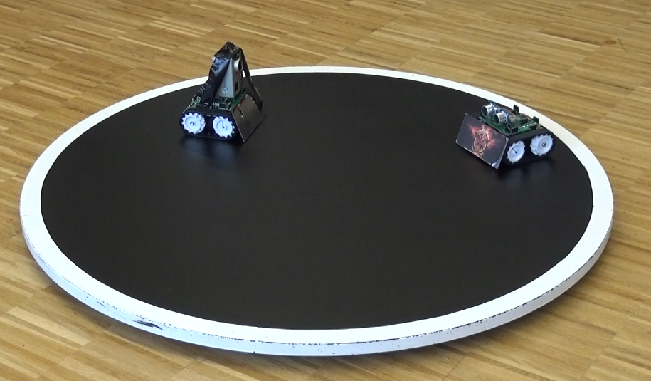

What is a Sumo Bot Competition?
Two robots are placed in a ring
Goal: attempt to push each other outside of ring.
Typically autonomous
First robot that touches outside of the ring loses the round.
The competitions “are non-destructive, family friendly, and great learning experiences.”
Classes of Sumo Bots
Japanese class (< 6.6 pounds)
Mini-class (< 1.1 pounds)
More information: http://www.robotroom.com/SumoRules.html
https://mcuoneclipse.com/2014/12/21/sumo-with-gopro-and-other-sumo-videos/
Mini Class
Japanese Class

Slide 16
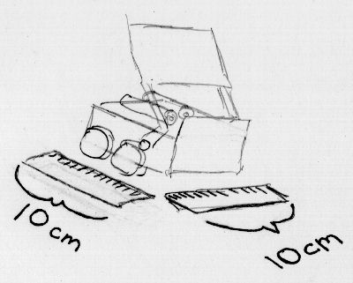

Mini-Class Requirements
Weight Constraint: < 500g(1.1lbs)
Size Constraints (at start of round)
Width: 10cm (3.93”)
Length: 10cm (3.93”)
Height: $∞$
Robots must not
Emit smoke or fire
Leak, stain, or soil
Disperse powder, grit, or grime
Spray, throw, or use projectiles
Jam, shock, or electromagnetically interfere
Snare, entangle, or employ nets/rope
Scratch, gouge, or scrape
Have sticky/magnetic/suction wheels
Qualification requirements
be able to navigate ring without being pushed
have button to move after 5 second delay
Rules are based on: http://www.robotroom.com/SumoRules.html

Slide 17
SPARC MINI-CLASS Part Requirements
up to 3 micro continuous servos
up to 2 servo wheels
all mechanical frame must be 3D printed
no sheet metal or raw plastics allowed
use any screws, nuts, washers
use Arduino Nano (clones), protoboard, wires, etc.
up to 2 Ultrasonic sensors
up to 4 line following sensors

Slide 18
Maker Training Session Topics
Version Control (Git and GitHub)
3D CAD Parts (Solidworks)
3D Printing (Lulzbot Taz 3 w/ Cura 3.1)
3D CAD Review and Assemblies (Solidworks)
Electrical Prototyping and intro to Arduino
Soldering and Electrical Fabrication
Basic Robotics Programming and PWM
Basic Sensor Programming

Slide 19
Maker Topic: Version Control and Git

Slide 20
Why use Version Control System (VCS)
Allows seamless collaboration on files
Provides a central location for files
Prevents loss of data by documenting all changes
If new bugs arise, files can be reverted back
Works with just about any file
Text based files allow line by line difference checking
Git is a VCS for software development
Repository
Version 1
Version 2
Version 3
commit
sync
commit
sync
commit
sync
User A
User B
User C

Slide 21

Definition of Terms
Repository (Master Branch)- a central location in which data is stored and managed.
Branch- an alternative version of the repository
Clone- copying of files from a repository into a local branch
Commit- push and pull from local branch to repository
Hotfix- a fix of a user specific bug

Slide 22

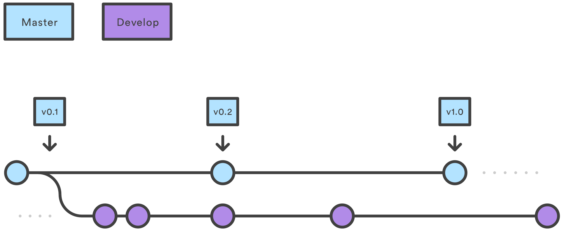
Basic Git Work Flow
https://www.atlassian.com/git/tutorials/comparing-workflows/gitflow-workflow

Slide 23
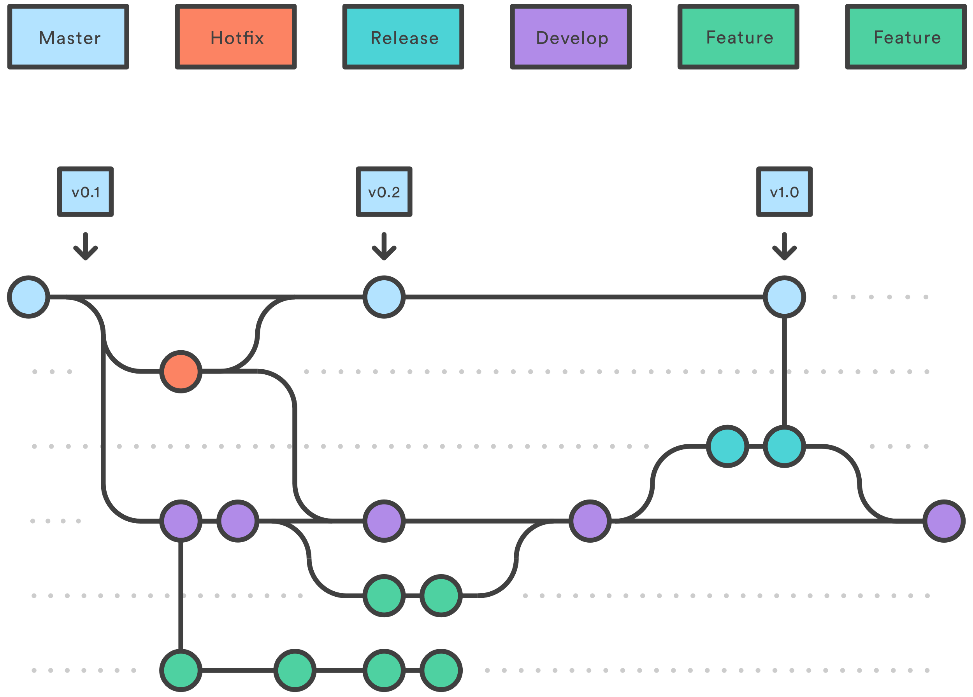
Expanded Git Work Flow
https://www.atlassian.com/git/tutorials/comparing-workflows/gitflow-workflow

Slide 24
What is GitHub
GitHub is an online Git VCS for software developers.
Advertised as “social coding”
It is free, open source, and widely used.
Is not limited to just software files.
SPARC projects and documents are highly integrated into GitHub
Other Popular Free Alternatives: Bitbucket and GitLab

Slide 25
Ways to Use Git and Github
Basic (GUI)
GitKraken
SourceTree
GitHub Desktop
Advanced (Terminal/GitBash)
Use terminal Commands after installing git on operating system
Example Commands:
git clone /path/to/repository
git commit -m "Commit message"
git push origin master
git pull
git status
More commands: https://git-scm.com/docs

Slide 26

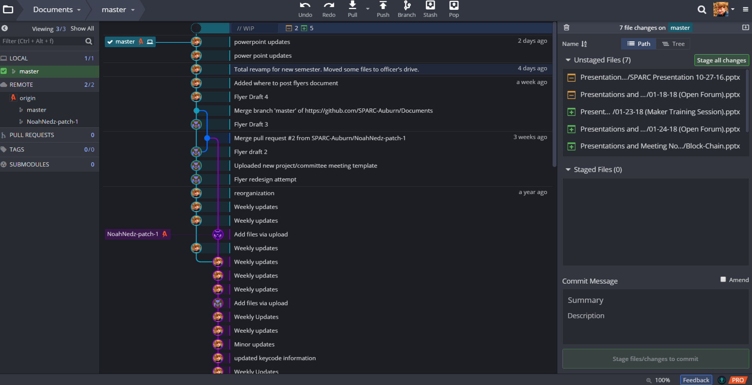
Using Git iN

Slide 27
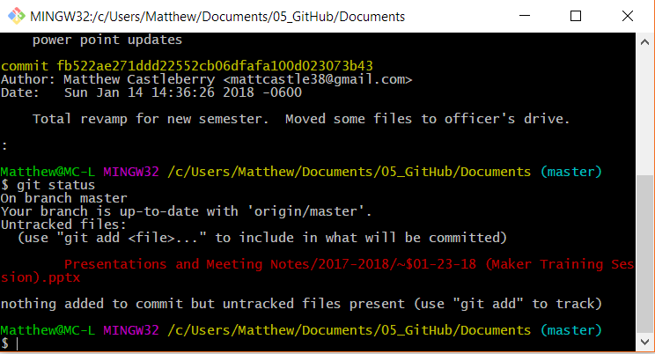
Using Git in Git Bash
Install from (https://git-scm.com/downloads)
Right click desired directory and press “GIT BASH Here”
Use commands in terminal
git clone, git commit, git push, git pull, etc.

Slide 28
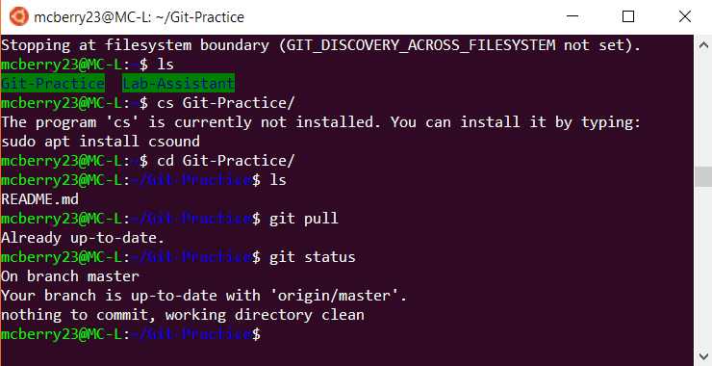
Using Git in Debian Linux
Ensure git is installed
sudo apt-get update
sudo apt-get install git
Change directory into desired location: cd directoryname
Use commands in terminal
git clone, git commit, git push, git pull, etc.

Slide 29
Typical Basic Git Procedure
Setup repository
> git clone “https://urltorepository”
> git init
Initial Commit
add files to folder
> git add –A
> git commit –m “Initial Commit”
> git push
Later Commits
> git pull
make file changes
> git add –A
> git commit –m “Description of changes”
> git push

Slide 30
Practicing Git
Many resources and tutorials are available online
Codecademy: https://www.codecademy.com/learn/learn-git
CodeSchool/Github: https://try.github.io/levels/1/challenges/1
Experiment with our practice GitHub repository
Github/SPARC-Auburn: https://github.com/SPARC-Auburn/Git-Practice

